Slide 1
Organizational Behavior
ISLT-644
Instructor: Erlan Bakiev, Ph.D.

Slide 2
Essentials of
Organizational Behavior, 11/e
Stephen P. Robbins & Timothy A. Judge
Chapter 13
Conflict and Negotiation

Slide 3
After studying this chapter, you should be able to:
Define conflict and differentiate between the traditional, interactionist and managed-conflict views of conflict.
Outline the conflict process.
Contrast distributive and integrative bargaining.
Apply the five steps of the negotiation process.
Show how individual differences influence negotiations.
Describe cultural differences in negotiations.

Slide 4

Conflict Defined
Process that begins when one party perceives that another party has negatively affected, or is about to negatively affect, something that the first party cares about.
Notes:
Conflict primarily deals with perception. If nobody thinks there is conflict then no conflict exists. Conflict can be experienced in an organization through many different avenues. It can be that the goals of the individuals are incompatible or there is a difference in opinion over the interpretation of facts. Many conflicts also arise through disagreements about how people should behave.

Slide 5
Transitions in Conflict Thought
Traditional View
All conflict is harmful and must be avoided
Interactionist View
Conflict is encouraged to prevent group from becoming stale
Resolution Focused View
Conflict is inevitable but we should focus on productive conflict resolution
Notes:
The traditional view of conflict believes that conflict is bad and it should be avoided as much as possible. This view was more prevalent in the 1930’s and 40’s than it is today. This view held that conflict was the result of poor communication, lack of openness or failure to respond to employee needs. All these things are negative and can be fixed. Thus management thought that conflict could be fixed and should be fixed.
The interactionist view of conflict does recognize that even though functional conflict can support the group’s goals and improve their performance there is also dysfunctional conflict that hinders group performance. This type of conflict should be avoided, controlled or minimized as much as possible.
The Resolution or managed conflict view recognizes the problems with creating conflict. And although they see conflict as inevitable in organizations, they believe we should work towards more productive methods of conflict resolution.

Slide 6
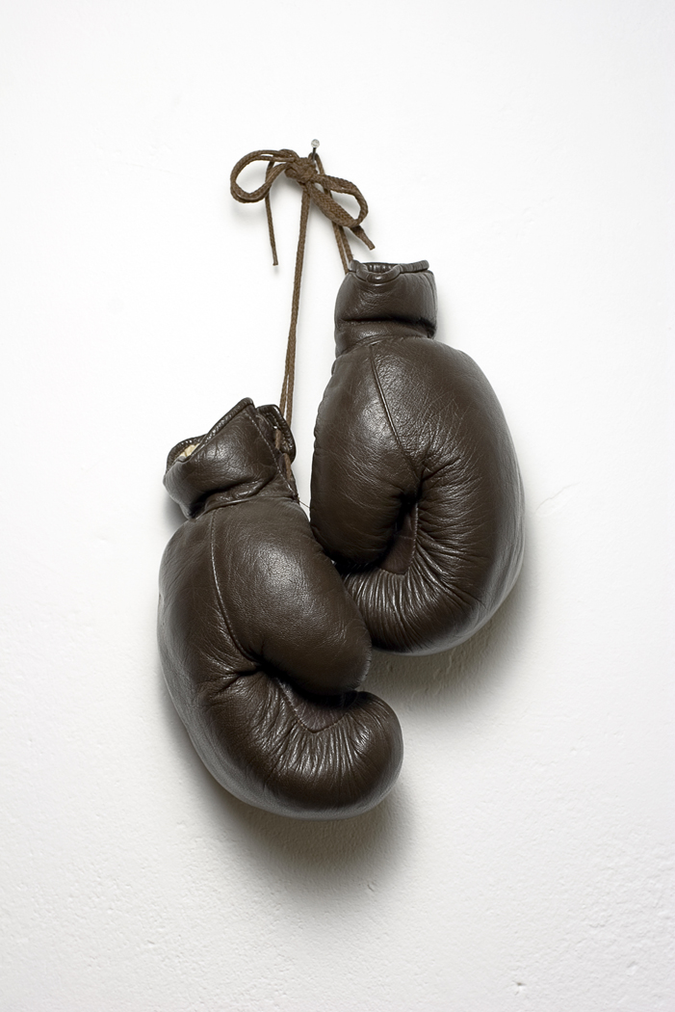
Functional Vs. Dysfunctional Conflict
Functional: improves group performance
Dysfunctional: hinders group performance
Assessing Focus of Conflict:
  Task – work content and goals
  Relationship – interpersonal
  Process – how the work is done
Notes:
Functional conflict will work towards improving group performance where dysfunctional conflict will hinder group performance.
You can assess the focus of conflict by looking at either task, relationship or process.

Slide 7

Desired Conflict Levels
Source of Conflict | Level of Conflict
 | Low | Moderate | High
Task | Functional |  | Dysfunctional
Relationship | Dysfunctional
Process | Functional | Dysfunctional
Notes:
Task conflict arises when there is conflict over the content and or goals of the work. If this type of conflict exists at low to moderate levels then this is a functional conflict that can help individuals seek clarification or new ideas on how to accomplish their goals.
Relationship conflict is based on problems between individuals and is almost always dysfunctional.
Process conflict occurs when there is disagreement on how the work gets done. Low levels of process conflict represent functional conflict.

Slide 8
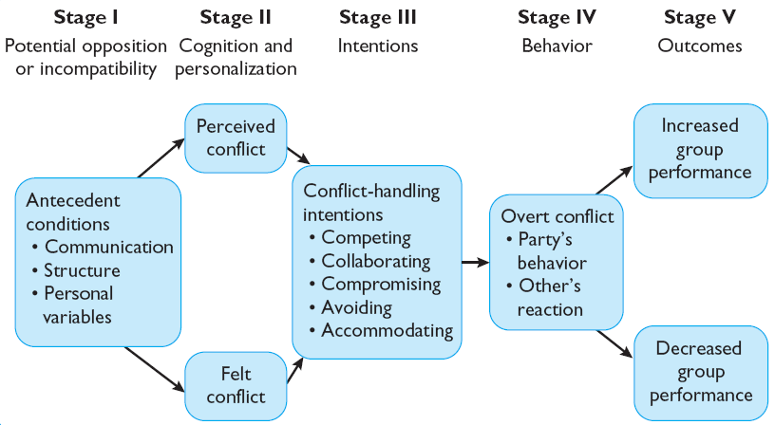
The Conflict Process
Notes:
The conflict process is outlined above, in the following slides we will look at each step individually.

Slide 9

Stage I: Potential Opposition
Communication
  Barriers Exist
  Too Much or Too Little
Structure
  Group Size, Age, Diversity
  Organizational Rewards, Goals, Group Dependency
Personal Variables
  Personality Types
  Emotionality
Notes:
Stage one of the conflict process is potential opposition or incompatibility. In this stage there are three main conditions that can cause conflict to arise. They are communication, structure and personal variables.
Communication may cause conflict when words mean different things to different people and misunderstandings result. Communication can be functional to a point, but when too much communication is given it can cause frustrations and sometimes there are barriers in place to effectively hear what is being communicated.

Slide 10
Stage II: Cognition and Personalization
Potential for conflict is actualized
Parties “make sense” of conflict by defining it and its potential solutions
Emotions play a major role in shaping perceptions
  Perceived Conflict – awareness needed for actualization
  Felt Conflict - emotional involvement - parties experience anxiety, tension, frustration, or hostility
Notes:
Stage two looks at the recognition or cognition of the conflict and the personalization or the emotional part of the conflict. As stated earlier, in order for conflict to be present there must be an awareness of its existence, defined as perceived conflict. Once people are aware of the conflict, emotions are expressed that can impact how the outcome of the conflict this is defined as felt conflict. Emotions can include anxiety, tension, frustration or hostility.

Slide 11
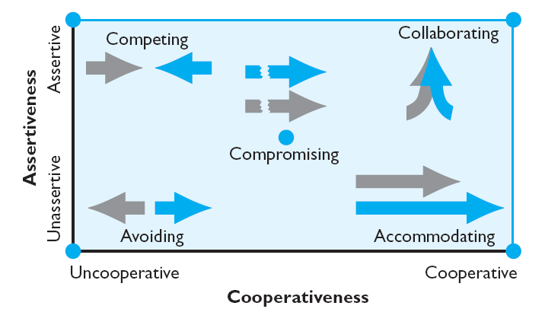
Stage III: Intentions
The decision to act in a given way
Inferred (often erroneous) intentions may cause greater conflict
Notes:
Stage three starts to look at the intentions of the individuals involved. These intentions include the determination to act in a certain way, but it is important to realize behavior does not always accurately reflect intention. Sometimes people act out of emotion and not rational thinking.
There are competing dimensions of conflict-handling intentions. One can be motivated by cooperativeness or attempting to satisfy the other party’s concerns or assertiveness, attempting to satisfy one’s own concerns. As the exhibit in this slide shows there are also variations of those two competing claims.

Slide 12
Stage IV: Behavior
Where conflict becomes visible
Usually overt attempts to implement each party’s intentions
May become an inadvertent stimulus due to miscalculations or unskilled enactments
  Functional Conflicts: confined to lower range of continuum – subtle, indirect, and highly controlled
  Dysfunctional Conflicts: upper range – highly destructive activities such as strikes and riots
Notes:
Stage four moves us beyond intentions to the chosen behavior in the conflict. This is when conflict becomes visible. Usually each party is using overt attempts to implement their own intentions.
This step may cause a reaction in others either because the individual miscalculated someone’s intentions or they were not skilled in translating their intentions into behavior. This can cause functional conflicts that may be helpful or dysfunction conflicts that can be highly destructive.

Slide 13
Stage V: Outcomes
Functional:
  Improves decision quality
  Stimulates creativity and innovation
  Encourages interest and curiosity
  Problems are aired
  Accepts change and self-evaluation
Dysfunctional:
  Group is less effective
  Cohesiveness and communications are reduced
  Leads to the destruction of the group
Notes:
Stage five looks at the outcomes of conflict resolution. Functional outcomes include increasing group performance, encouraging interest and curiosity and creating an environment for self-evaluation and change. Dysfunctional outcomes include discontented workers, reduced group cohesiveness and infighting. In order to create functional conflict it is important to reward dissent and punish conflict avoiders.

Slide 14

Creating Functional Conflict
Managers can reward dissent and punish conflict avoiders
Managers must learn to accept bad news without sending cues that conflict is unacceptable
Notes:
Managers can work to create functional conflict by rewarding dissent and punishing conflict avoiders. However, it is a skill for managers to accept bad news without sending cues that conflict is unacceptable and it is a skill that needs to be developed.

Slide 15
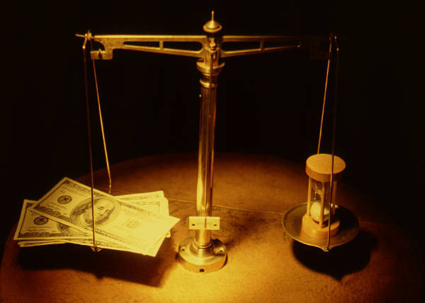
Negotiation
Process in which two or more parties exchange goods or services and attempt to agree on the exchange rate for them
Notes:
Having a good understanding of conflict and conflict resolution it is now important to look at negotiation. Negotiation or bargaining is the process where the people involved work on creating a deal that is mutually beneficial

Slide 16
Bargaining Strategies
Notes:
There are two main approaches – distributive and integrative. Distributive bargaining seeks to divide up a fixed amount of resources and often creates a win/lose situation. Integrative bargaining seeks one or more settlements that can create a win-win situation for all parties involved.

Slide 17
Distributive Bargaining Zones
B’s Target Point
A’s Target Point
Player
A
B’s Aspiration Range
A’s Aspiration Range
Player
B
B’s Resistance Point
A’s Resistance Point
Settlement Range
Notes:
This chart shows the various zones in the distributive bargaining process.

Slide 18

Necessary Conditions for Integrative Bargaining
Parties must be open with information and candid about their concerns
Both parties must be sensitive regarding the other’s needs
Parties must be able to trust each other
Both parties must be willing to be flexible
Notes:
In order for integrative bargaining to be successful, parties must be open with information and candid about their concerns. In addition, both parties must work to pay attention to the needs of the others involved. This all needs to happen so trust occurs. In the process both parties must be willing to be flexible in working towards a solution.

Slide 19

The Negotiation Process
BATNA
Notes:
The negotiation process is best understood through the negotiation process. The grid in this slide outlines the steps: Preparation and planning, definition of ground rules, clarification and justification, bargaining and problem solving and closure and implementation. You should determine your and the other party’s BATNA before proceeding with negotiations. BATNA represents the Best Alternative To a Negotiated Agreement or the lowest acceptable value you will take for a negotiated agreement. Than anything above your BATNA is a good negotiated outcome.

Slide 20
Individual Differences in Negotiation
Personality
  Little evidence to support
  Disagreeable introvert is best
Moods & Emotions
  Showing anger helps in distributive negotiations
  Positive moods help integrative negotiations
Gender
  Men are slightly better
  Many stereotypes – low power positions
  Women’s self-image as negotiators is poor
Notes:
Many individual differences are interwoven in the negotiation process and impact the effectiveness of the outcomes. Personality traits will impact outcomes as extroverts tend to be weaker at negotiation because they will want people to like them. Intelligence is not an indicator of effective negotiation skills.
Mood and emotion can impact negotiations as anger is often an effective tool in distributive bargaining, whereas positive moods are helpful in integrative bargaining situations.
Gender can also impact negotiation effectiveness. Men and women tend to approach negotiations in the same way but may view the outcomes differently. Women may appear more tender in the process where men come across as tough. On the average, men are more likely to be negotiators than women.

Slide 21

Global Implications
Conflict and Culture:
Insufficient research at this point
Initial evidence does suggest some differences in tactics and attitude
Cultural Differences in Negotiations:
Negotiating styles clearly vary across national cultures
Notes:
There are numerous global implications in the area of conflict as different cultures will view conflict through unique lenses. For example, US managers are more likely to use competing tactics where as Japanese managers will tend towards compromise and avoidance.
The different viewpoints of conflict will play out in the arena of negotiations and the styles utilized. American negotiators will often make the first offer where Japanese negotiators will wait. North Americans use facts to persuade, Arabs use emotions and Russians will speak more in ideals. Brazilians tend to say no when negotiating much more than Americans or Japanese negotiators will do so.

Slide 22
Implications for Managers: Managing Conflict
Use in the appropriate situations:
  Competition – quick action is vital
  Collaboration – to gain commitment with consensus
  Avoidance – the issue is trivial
  Accommodation – when you’re wrong
  Compromise – opponents have equal power and hold mutually exclusive goals
Notes:
Conflict is a natural part of the organizational context and it can be constructive or destructive. Excess conflict can be reduced through competition, collaboration, avoidance, accommodation or compromise. In the end, it is best to seek a negotiation strategy that is a win-win for all parties.

Slide 23
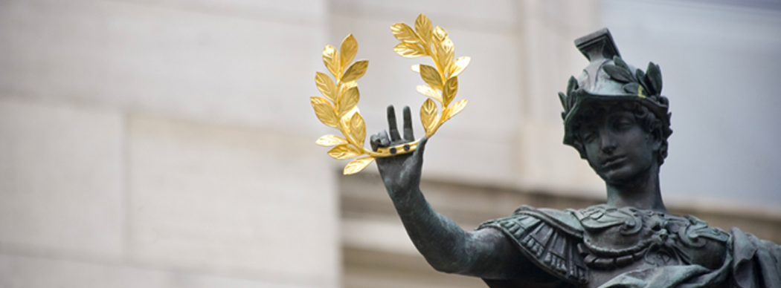
Implications for Managers: Improving Negotiation Skills
Set Ambitious Goals
Pay Little Attention to Initial Offers
Research Your Opponent
Address the Problem, Not the Personalities
Be Creative - Emphasize Win-Win Solutions
Notes:
When managers are working on their negotiation skills they must: set ambitious goals, ignore initial offers, research the opponent, address the problem and ignore personalities and be creative.

Slide 24
Keep in Mind…
Conflict is an inherent part of organizational life: probably necessary for optimal organizational function
Task conflict is the most constructive
Most effective negotiators use both types of bargaining and know the appropriate tactics
Notes:
Conflict is a normal part of organizational life and could be necessary for an organization to operate as effectively as possible. The most constructive type of conflict is task.
The most effective negotiators will use the bargaining techniques we discussed in this chapter and will know what the appropriate tactics are.

Slide 25
Summary
Defined conflict and differentiated between the traditional, human relations, and interactionist views of conflict.
Outlined the conflict process.
Contrasted distributive and integrative bargaining.
Applied the five steps of the negotiation process.
Showed how individual differences influenced negotiations.
Described cultural differences in negotiations.

